Slide 1
Day3 LINUX HISTORY AND COMMANDS
LINUS DEVICE DRIVER TRAINING- GAZAL

Slide 2
HISTORY AND PHILOSPHY OF LINUX
History of Linux:
Origin: Linux was created by Linus Torvalds, a Finnish computer science student, in 1991. He developed it as a hobby project while studying at the University of Helsinki. Torvalds initially intended to create an operating system for his personal computer, inspired by UNIX.
Open Source Collaboration: Torvalds released Linux under the GNU General Public License (GPL), which made it freely available for anyone to use, modify, and distribute. This decision laid the foundation for Linux's collaborative development model, with contributions from developers worldwide.
Philosophy of Linux:
Open Source: At the core of Linux's philosophy is the concept of open source software. The GPL ensures that Linux remains open for anyone to inspect, modify, and distribute. This openness fosters collaboration, innovation, and transparency within the development community.
Freedom and Choice: Linux offers users freedom and choice in how they use and customize their computing environment. Unlike proprietary operating systems, Linux users have full control over their systems, allowing them to tailor them to their specific requirements without being locked into a single vendor's ecosystem.
Community Collaboration: Linux development is a collaborative effort involving thousands of developers worldwide. This diverse community contributes to the ongoing improvement and evolution of the Linux ecosystem, sharing code, ideas, and expertise through mailing lists, forums, and collaborative platforms like GitHub.
Stability and Reliability: Linux is known for its stability, reliability, and performance. These qualities make it particularly well-suited for mission-critical applications, such as servers, where downtime can have significant consequences. The open development model and rigorous testing processes contribute to Linux's reputation for stability.
Compatibility and Portability: Linux supports a wide range of hardware architectures, from desktop computers to embedded devices and supercomputers. This flexibility makes Linux suitable for a diverse range of applications and ensures compatibility across different platforms.
In summary, the history and philosophy of Linux reflect a commitment to openness, collaboration, freedom, and innovation, which have contributed to its widespread adoption and enduring popularity in the world of computing.

Slide 3
LINUX COMMAND BASICS
Linux commands are case-sensitive, ls is not same as LS.
Linux commands may have options that come after the command that start with a “-” and followed by a letter or “- -” and a word:
$ls –r
$ls –reverse
Linux commands may allow for arguments:
$ls/tmp
You can run more than one command on the same line by separating the commands with a semicolon(;)
$ls;date
Most linux commands have a manual page or help to describe how they can be used
$man anycommand

Slide 4
CONCEPTS:FILES AND PROCESSES
In Unix , and by extension , Linux ,everything is either a file or a process.
Meaning everything can be interfaced via the file system(s)
Files: text , data , documents , traditional files
Directories :these are special text files that contain a bunch of other files
Devices: all disks , video hardware , audio hardware , processors , memory , USB ports-all hardware can be interfaced via files.
Processors: All running processes can be “seen “ via the file system-each has unique identifier.

Slide 5
Pathnames for files
Every file has a unique path to its location for example:
/home/student2/Projects/docs/final_report.doc
‘ /home/student2' is the home directory for student2
'Projects' is a directory in /home/student2 - student2 is the parent directory of Projects
'docs' is a directory in 'Projects' - docs is a subdirectory or child directory of Projects
'final_ report.doc' is a file in 'docs'

Slide 6
SOME COMMANDS
man - short form for "manual" and is used to display the manual pages for Unix commands and other system functions. These manual pages provide detailed information about the usage, options, and syntax of various commands and utilities available on the system.
$man[command]
$man ls
pwd – This command stands for "print working directory." It is used in Unix-like operating systems, including Linux, to display the current working directory.
$pwd
cd - Linux cd command is used to change the current working directory ( i.e., in which the current user is working). The "cd" stands for 'change directory.' It is one of the most frequently used commands in the Linux terminal.
whoami - The 'whoami' command in Linux is a built-in utility that displays the username of the current user. It is used with the syntax, whoami [option] .
rm - The 'rm' means remove. This command is used to remove a file. The command line doesn't have a recycle bin or trash unlike other GUI's to recover the files. Hence, be very much careful while using this command. Once you have deleted a file, it is removed permanently.
$rm filename
cp - The cp command is used to copy directories and files. The command contains three primary operation modes, represented by the argument types shown to the program to copy a file to other files, multiple files to any directory, or to copy the whole directories to other directories.
$cp -r <sourceDirectory> <destinationDirectory>
touch - It is used to create a file without any content. The file created using the touch command is empty. This command can be used when the user doesn’t have data to store at the time of file creation.
$touch filename

Slide 7
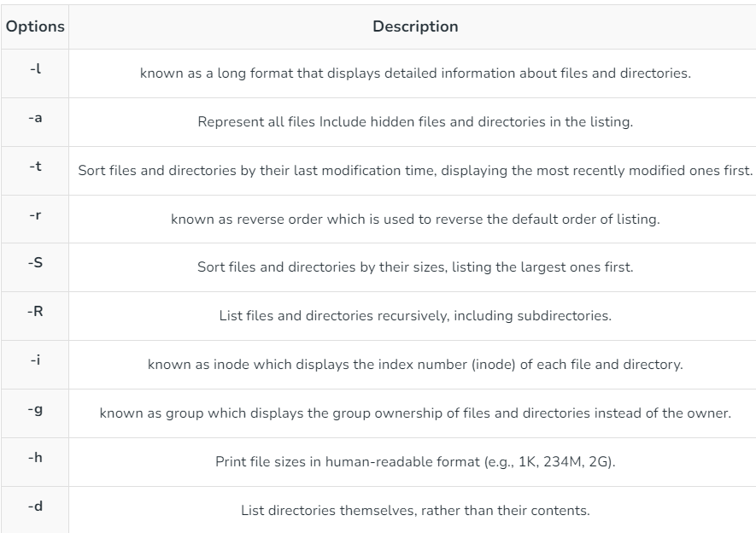
LS COMMAND
Ls - It is used to list the contents of a directory. When you run ls without any arguments, it lists the files and directories in the current directory.
You can also use various options with the ls command to customize its behavior. Some common options include:

Slide 8
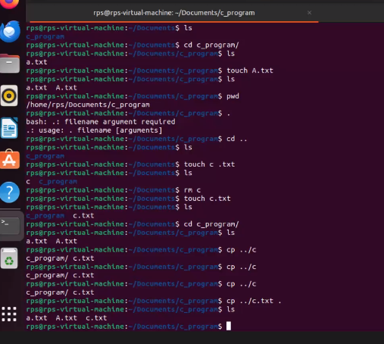
USING COMMANDS IN TERMINAL

Slide 9
nano command
nano command is a simple text editor that is commonly available on Unix-like operating systems, including Linux. It's often used as a straightforward and easy-to-use alternative to more advanced text editors like Vim or especially for new users or those who prefer a simpler interface.
Syntax: $nano filename
This will open the file in the text editor. If the file doesn't exist, nano will create it when you save your changes.
Some common keyboard shortcuts in nano include:
Ctrl + g : Display the help menu, which provides a list of available commands.
Ctrl + o : Save the file (Write Out).
Ctrl + x : exit nano , If changes have been made, nano will prompt you to save them before exiting.
Ctrl + w : Search for text within the file.
Ctrl + k: Cut the current line.
Ctrl + u: Uncut (paste) the last cut text.
Ctrl + c: Display current cursor position

Slide 10
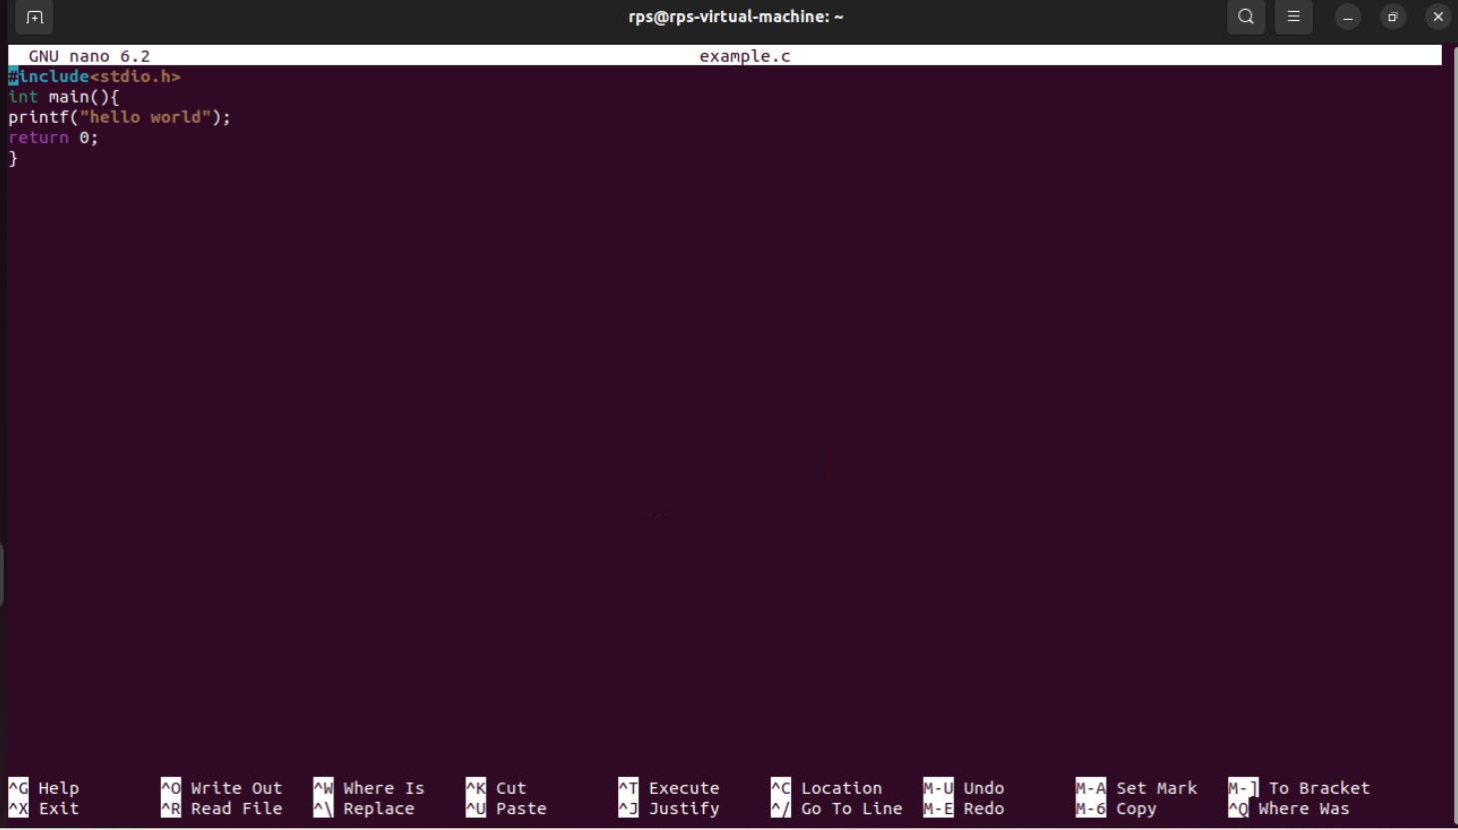
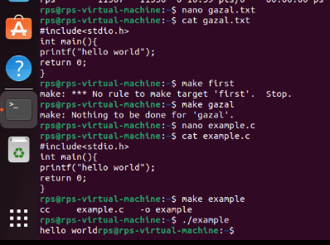
Printing hello world through nano command
When I write nano example.txt
This text editor opens
make example: making executable file to compile program
Cat command: use to display content of files

Slide 11
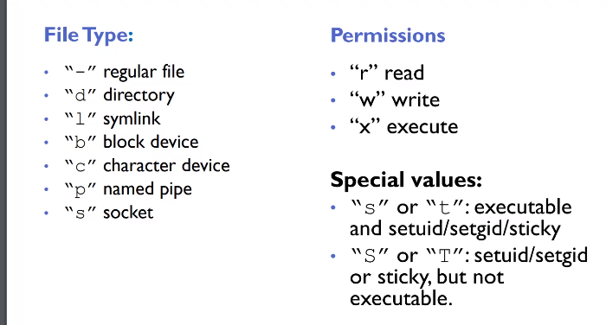
Ownership & Permissions
Linux system are multi user environments that allow users to create files,run programs and share data
Files and directories have two types of ownership – the user and group. A linux group consist of one or more users.
Files and directories have three types of access permissions:
Read permission(r)
Write permission(w)
Execute permission(x)
Every file and directory has permissions for three levels or entities of permissions:
A) user or owner(denoted by u)
B)group(one or more users –denoted by g)
Others or world(denoted by o)

